Slide 1

IBM SkillsBuild Decoding Data PBL Program 2025 Final Project Presentatio Final Project Presentation
Project topic : Netflix Trend Analysis Team Name : CellSquad40
College name: Vivekananda Institute Of Professional Studies

Slide 2
Team Members
Ananya Singh - singhananyas123@gmail.com
Vinayak Jain - vinayakjainn11@gmail.com
Aditi Bansal - bansaladiti683@gmail.com
Prabhjot Singh - ps844601@gmail.com

Slide 3
Introduction
Goal: To create an interactive dashboard that provides actionable insights into Netflix's content strategy and library composition.
Objective: To analyze the Netflix content library to identify key trends in genre popularity, content release schedules, and geographical distribution.

Slide 4
Problem Identification
Problem Statement
In the face of a massive and ever-expanding digital library, Netflix stakeholders lack a simple, efficient way to get a clear overview of their content strategy. It is difficult to answer critical business questions about genre dominance, content acquisition trends, and geographic diversity from raw data alone, hindering strategic planning.
Significance of the Problem
Solving this problem is significant because it transforms raw data into actionable intelligence. An effective analytics dashboard empowers data-driven decisions on content acquisition, helps align the library with strategic goals (like global diversification), and saves countless hours of manual data analysis, allowing teams to focus on strategy instead of spreadsheets.
Relevant SDGs (Sustainable Development Goals)
This project indirectly supports several UN Sustainable Development Goals by analyzing the diversity and nature of global media content:
SDG 4 (Quality Education): By analyzing the volume of documentaries and educational content, the dashboard can provide insights into the platform's role in informal learning and public awareness.
SDG 8 (Decent Work and Economic Growth): The analysis highlights which countries are major content producers, reflecting the growth of the creative economy and job creation in the media sector in those regions.
SDG 10 (Reduced Inequalities): By visualizing the geographic diversity of content, the dashboard measures the representation of different cultures and nations in global media, which is a key factor in promoting cultural understanding and reducing inequalities.

Slide 5
Data Collection
Source of Data
Platform: Kaggle
Dataset: "Netflix Movies and TV Shows“
Data Description
A single CSV file with metadata for over 8,800 Netflix titles.
Key columns: type, title, country, release_year, listed_in (genre), and date_added.
Data Collection Method
The netflix_titles.csv file was downloaded directly from the dataset's page on Kaggle.

Slide 6
Data Preprocessing
Data Cleaning Method
Genre & Country Columns: Split cells with multiple values (e.g., "Dramas, International Movies") into separate rows to allow for accurate counting and filtering of each individual category.
Text Formatting: Trimmed excess whitespace and standardized text (e.g., "mins" to "min") before converting to numbers to prevent errors.
Handling Missing Values
Filtering: Rows with blank country information were removed to avoid skewing the geographic analysis.
DAX Formulas: Used the IFERROR and BLANK() functions in calculations to ensure that KPIs (like average duration) would ignore rows with missing data instead of producing an error.
Data Transformation Techniques
Data Type Conversion: Changed the date_added column from text to a proper Date type to enable time-based analysis and trends.
Calculated Columns: Created a new column, "Movie Duration (Mins)," using DAX to extract the numerical runtime from the original text-based duration field (e.g., "90 min" -> 90).

Slide 7
Data Analysis
Analytical Tool and Method Used
Tool: Microsoft Power BI was used for end-to-end analysis.
Method:
ETL (Extract, Transform, Load): Power Query was used to clean, reshape, and prepare the raw data for analysis.
Data Modeling: DAX (Data Analysis Expressions) was used to create custom calculations and Key Performance Indicators (KPIs).
Visualization: An interactive dashboard was built to visualize trends and allow for dynamic data exploration through filters and charts.
Key Findings
Content Growth: There was a dramatic increase in the amount of content added to Netflix starting around 2017. 📈
Genre Popularity: International Movies, Dramas, and Comedies are the most common genres in the library.
Geographic Distribution: The United States is the top content-producing country, followed by India and the United Kingdom.
Content Mix: The library contains a higher number of movies compared to TV shows.
* Insights Derived
Strategic Shift: The surge in content after 2017 reflects Netflix's strategic shift towards becoming a global content powerhouse with a heavy investment in original and licensed programming.
Global-First Approach: The dominance of "International Movies" and the strong presence of content from countries like India signify a successful strategy to cater to a global audience, not just a Western one. 🌍
Broad Audience Appeal: By focusing on widely popular genres like dramas and comedies, Netflix ensures it has a catalog with broad appeal, maximizing its potential subscriber base.

Slide 8
Hypothesis Development
Formulated Hypothesis
As Netflix expanded globally, its content acquisition strategy deliberately shifted to prioritize international content over U.S.-based content to attract and retain a diverse, global subscriber base.
Rationale Behind the Hypothesis
Initial analysis in the dashboard shows a high volume of content from countries like India and the UK, and "International Movies" is a top genre. This suggests a conscious effort to diversify the library beyond purely American productions, which would be a logical strategy for a company aiming for worldwide market leadership.
Method for Testing
The hypothesis can be tested directly within the Power BI dashboard using the following steps:
Filter by Year: Use the "Content Added to Netflix by Year" line chart to select a recent year (e.g., 2019 or later).
Observe Country Chart: Analyze the "Top 10 Countries" bar chart. If the hypothesis is correct, the proportion of content from non-U.S. countries will be significantly higher in recent years compared to earlier years.
Cross-Reference with Genre: Filter the dashboard by the "International Movies" and "International TV Shows" genres and observe which years show the highest volume.

Slide 9
Solution Design
Proposed Solution
The proposed solution is the development and deployment of an interactive Power BI dashboard. This tool directly addresses the problem by consolidating raw Netflix data into an easy-to-understand visual format, enabling stakeholders to explore content trends, genre popularity, and geographic distribution with just a few clicks.
Implementation Plan
Data Acquisition: Download the "Netflix Titles" dataset from Kaggle.
Data Cleaning (ETL): Use Power Query to clean and transform the data, focusing on splitting multi-value columns (genre, country) and correcting data types.
Dashboard Development: Build the visuals in Power BI, creating charts for key metrics and setting up interactive slicers.
Deployment: Publish the dashboard to the Power BI service for secure sharing with stakeholders.
Alignment of SDGs
This project aligns with several UN Sustainable Development Goals (SDGs) by analyzing the diversity of global media:
SDG 8 (Economic Growth): Highlights the growth of the creative economy in various countries.
SDG 10 (Reduced Inequalities): Measures the media representation of different cultures, promoting cultural understanding.

Slide 10
Visualization
Prominent Features of the Platform
The Power BI dashboard is built around several key features designed for intuitive data exploration:
Interactive KPI Cards: At-a-glance metrics like "Total Movies" and "Total TV Shows" that update instantly as filters are applied.
Dynamic Slicers: Easy-to-use dropdown filters for Type, Genre, and Country that allow users to drill down into the data and customize the entire report view.
Time-Series Line Chart: Visualizes the volume of content added to Netflix over the years, making it easy to spot key trends and growth periods.
Top 10 Bar Charts: Automatically ranked charts that display the most dominant genres and content-producing countries, providing quick comparative insights.
Cross-Filtering: Clicking on any element (like a bar in a chart or a point on the line chart) automatically filters all other visuals on the page, enabling seamless, interactive analysis.
Sitemap
Since this is a single-page dashboard, the sitemap represents the high-level architecture and user flow on that one page.
Homepage: Netflix Content Dashboard
Header Section
Dashboard Title
KPI Card: Total Movies
KPI Card: Total TV Shows
KPI Card: Total Unique Genres
Filter Pane (Slicers)
Filter by Content Type (Movie/TV Show)
Filter by Genre
Filter by Country
Main Content Area
Primary Visual: Content Added to Netflix by Year (Line Chart)
Secondary Visual 1: Top 10 Genres (Bar Chart)
Secondary Visual 2: Top 10 Countries (Bar Chart)

Slide 11
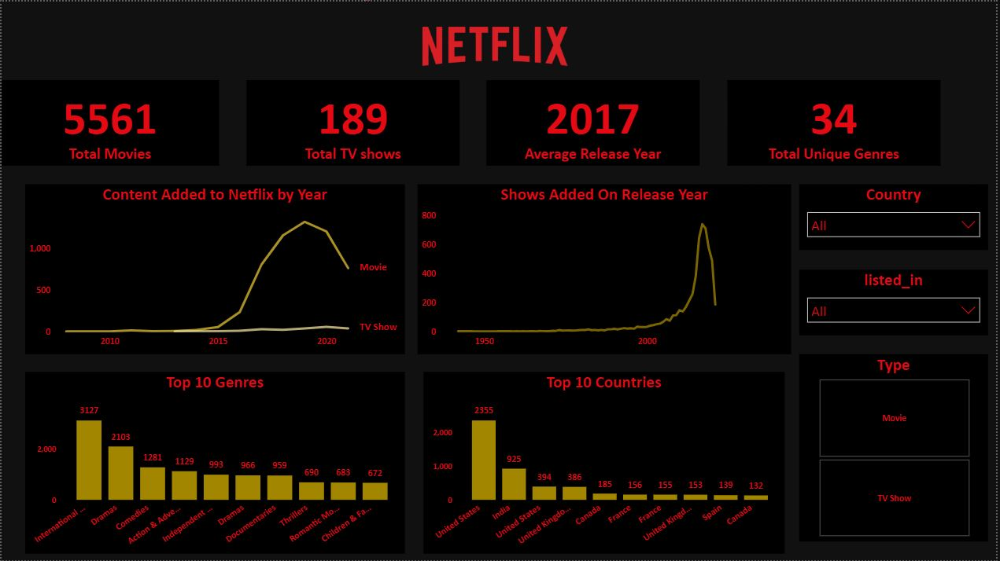
Conclusion
The proposed Power BI dashboard will transform decision-making by converting raw data into actionable insights. It enables executives to make smarter, data-driven content investments, boosts operational efficiency by automating manual analysis, and fosters a data-centric culture where all stakeholders can easily explore and understand key business trends.

Slide 12
References
Tools and Software Used
Microsoft Power BI Desktop: The primary tool used for data cleaning, transformation, analysis, and visualization.
Power Query: The integrated ETL (Extract, Transform, Load) engine within Power BI used for data preparation.
DAX (Data Analysis Expressions): The formula language used within Power BI to create custom calculations and key performance indicators (KPIs).
Kaggle: The platform used to source the initial dataset.
Additional References
Dataset Source: Netflix Movies and TV Shows on Kaggle
Official Software Documentation: Microsoft Power BI Documentation
Further Reading: "Storytelling with Data: A Data Visualization Guide for Business Professionals" by Cole Nussbaumer Knaflic - A highly recommended book for improving data presentation and dashboard design.

